Slide 1


BILANCIO IDRICO TRANSFRONTALIERO DEI BACINI IDROGEOLOGICI CON METODOLOGIE INTEGRATE E DI ADATTAMENTO AI CAMBIAMENTI CLIMATICI
ČEZMEJNA VODNA BILANCA HIDROGEOLOŠKIH POREČIJ Z INTEGRIRANIMI METODOLOGIJAMI IN PRILAGAJANJEM PODNEBNIM SPREMEMBAM
Contaminanti emergenti nelle acque dolci e negli scarichi:
Nastajajoči ones-naževalci v sladkih vodah in izpustih:
NUOVI APPROCCI E CAPACITÀ ANALITICHE
PROSIMO DODAJTE TUKAJ
PODNASLOV DOKUMENTA
Pierluigi Barbieri Università degli Studi di Trieste
Pierluigi Barbieri
Università degli Studi di Trieste

Slide 2



PB
Professore Associato di Chimica Ambientale @
Dipartimento di Scienze Chimiche e Farmaceutiche – Università degli Studi di Trieste
Coordinatore Spoke 8 ”Maritime, marine and inland water technologies: towards the Digital Twin of the Upper Adriatic” dell’Ecosistema Integrato dell’Innovazione del Nord Est (INEST www.consorzioinest.it) finanziato da NextGenerationEU-MUR-PNRR ItaliaDomani
Coordinatore Cross Cutting Activity 2 INEST Spoke 8 “Lab Villages”
con il Polo Tecnologico Alto Adriatico

Slide 3
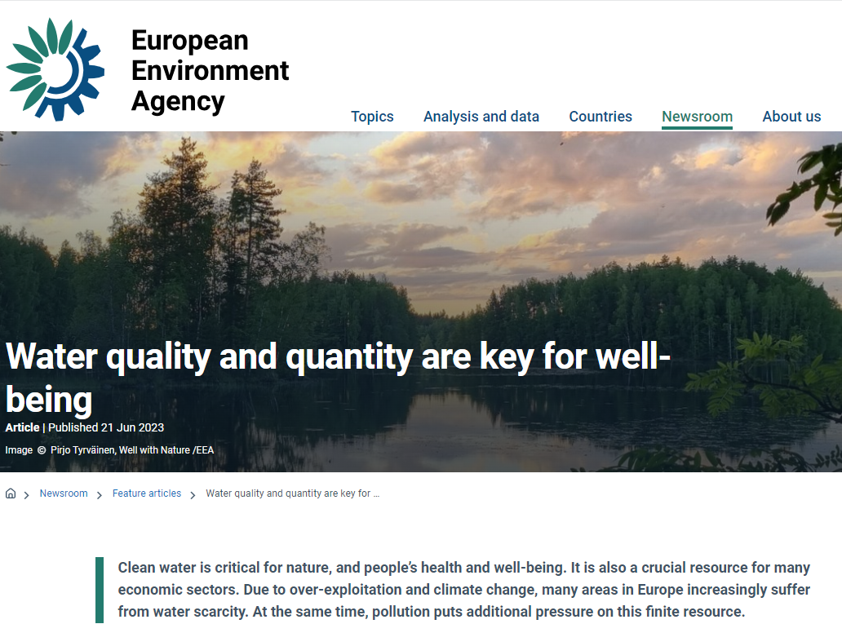
BILANCIO IDRICO TRANSFRONTALIERO DEI BACINI IDROGEOLOGICI CON METODOLOGIE INTEGRATE E DI ADATTAMENTO AI CAMBIAMENTI CLIMATICI
ČEZMEJNA VODNA BILANCA HIDROGEOLOŠKIH POREČIJ Z INTEGRIRANIMI METODOLOGIJAMI IN PRILAGAJANJEM PODNEBNIM SPREMEMBAM
https://www.eea.europa.eu/en/newsroom/editorial/water-quality-and-quantity
INTERREG ITA-SLO WABIN – Seminar “The problem of transboundary waters” and Kick Off Meeting
Trieste Urban Center – 05/07/2024
PROJECT
Notes:
If you want to go for a swim in Europe, there is a very good chance that the water quality at your chosen bathing site is excellent. Besides, most European residents can enjoy good quality drinking water straight from the tap.
However, Europe needs to reduce water pollution from agricultural land and industry, and improve wastewater treatment. This is because new evidence is emerging about micro pollutants, microplastics and antimicrobial resistance affecting water quality. At the same time, climate change is increasingly threatening water resources in some areas

Slide 4
Groundwater supplies about 65% of drinking water in the EU. However, according to the latest EEA assessment on this vital resource, chemical pollution has been found in about quarter of EU groundwaters, while almost 10% of groundwaters are affected by unsustainable level of abstraction.
Moreover, excessive levels of one or more pesticides were detected at between 4% and 11% of groundwater monitoring sites.
Other health concerns include plastic pollution, microplastics from textiles and chemical pollutants, such as PFAS, that are found across Europe in soil and water.
https://www.eea.europa.eu/en/newsroom/editorial/water-quality-and-quantity

Slide 5
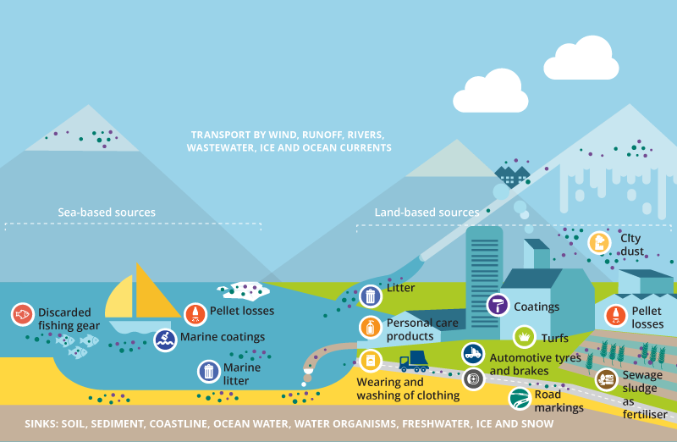
Sources of microplastics, release routes and sinks
Source: Illustration by the Collaborating Centre on Sustainable Consumption and Production (CSCP) for the European Topic Centre on Circular Economy and Resource Use (ETC/CE) and the EEA

Slide 6
Many existing EU laws and new ambitions for water
Currently, key pieces of EU legislation on water and human health concern drinking water, bathing water and urban wastewater. Meanwhile, the Water Framework Directive reflects the overall goal to achieve good status for Europe’s rivers, lakes and groundwater. At the same time, other policies and regulations on agriculture, industry, chemicals and other sectors also have strong links to water.
The European Green Deal's ambition to have an environment free of harmful pollution by 2050 also concerns water. As part of the zero pollution action plan, the European Commission proposed stronger rules curbing surface and groundwater pollutants, and better urban wastewater treatment.
The proposals’ aims include better and more cost-effective urban wastewater treatment, recovering nutrients, producer responsibilities for micropollutants and new monitoring requirements for microplastics. The Commission is also proposing to update the list of water pollutants and more strictly control what goes into surface waters and groundwater. These substances include PFAS, pesticides, Bisphenol A and some pharmaceuticals.
https://www.eea.europa.eu/en/newsroom/editorial/water-quality-and-quantity

Slide 7
Pollutants in EU waters
Update of chemical substances listed for control
As required by EU water legislation, and in line with the European Green Deal's zero pollution ambition, on 26 October 2022 the European Commission tabled a proposal to revise the lists of surface water and groundwater pollutants that need to be monitored and controlled for the purpose of protection of EU freshwater bodies, and the associated environmental quality standards.
The proposal also seeks to remedy shortcomings identified in the current framework as regards chemical pollution in waters, and notably to enable swifter adaptation to scientific knowledge.
On 16 May 2024 the Commission notified a Delegated Decision on a methodology to measure microplastics in water intended for human consumption
.
https://www.europarl.europa.eu/RegData/etudes/BRIE/2023/749772/EPRS_BRI(2023)749772_EN.pdf

Slide 8
The proposed directive, to be transposed into national law within 18 months of entry into force, amends the WFD and its two daughter directives, the EQSD and the GWD.
Surface waters
The proposal would add 23 individual substances to the list of priority substances
pharmaceuticals (macrolide antibiotics, estrogenic hormones , carbamazepine, diclofenac, ibuprofen);
industrial chemicals (bisphenol A);
metals(silver);
pesticides(triclosan, nicosulfuron, glyphosate, neonicotinoids, pyrethroids + total of active substances in pesticides).
24 PFAS would be added as a group to the list of priority substances, (quality standard = sum of substance concentrations).
Some substances would be deselected from the list (the pesticides alachlor, chlorfenvinphos, simazine; and carbon tetrachloride, an industrial chemical).
river basin-specific pollutants, currently considered under 'ecological status', would be incorporated into the assessment of surface waters' chemical status.
https://www.europarl.europa.eu/RegData/etudes/BRIE/2023/749772/EPRS_BRI(2023)749772_EN.pdf

Slide 9
Ground waters
New groundwater pollutants with related quality standards added to Annex I (EU-wide standards) include PFAS (group of 24, as for surface water), the pharmaceuticals carbamazepine and sulfamethoxazole (with individual environmental quality standards – EQS), and non-relevant EPRS | European Parliamentary Research Service 6 metabolites of pesticides (individual and total). The proposal would also set a standard for the total of pharmaceutical active substances. The pharmaceutical primidone would be added to the list of synthetic substances for which Member States have to consider setting national threshold values(Annex II to the GWD). As for river basin specific pollutants, the Commission would have the power to adopt delegated acts to set, where necessary, harmonised threshold values for groundwater pollutants of national, regional or local concern, and list them in the repository added to Annex II GWD. T
https://environment.ec.europa.eu/topics/water/drinking-water_en

Slide 10
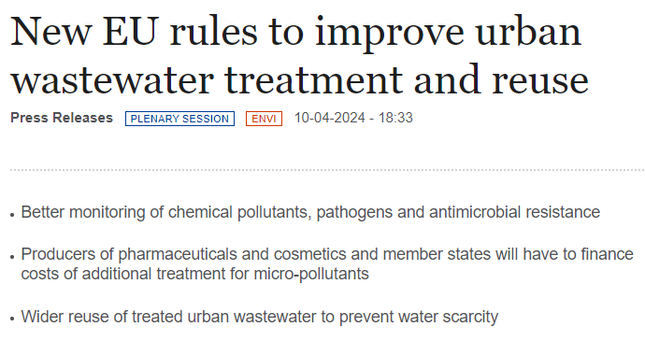
With 481 votes in favour, 79 against and 26 abstentions, Parliament adopted the deal reached with the Council in January 2024 on revising the EU’s water management and urban wastewater treatment standards to better protect public health and the environment
….
The monitoring of various public health parameters (such as known viruses and emerging pathogens), chemical pollutants, including so-called “forever chemicals” (per- and polyfluoroalkyl substances or PFAS), microplastics and antimicrobial resistance will be strictly monitored.
https://www.europarl.europa.eu/doceo/document/TA-9-2024-0222_EN.pdf
https://www.europarl.europa.eu/news/en/press-room/20240408IPR20307/new-eu-rules-to-improve-urban-wastewater-treatment-and-reuse

Slide 11
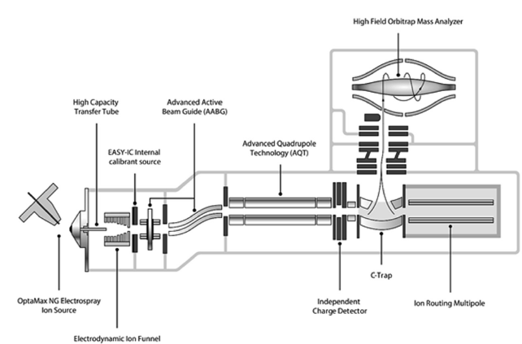
New tools for identifying emerging pollutants
(also «unknown compounds»): weighting molecules by mass spectrometer implementing Orbitrap technology
Schematics of Orbitrap Exploris mass spectrometer with main units indicated by their names

Slide 12
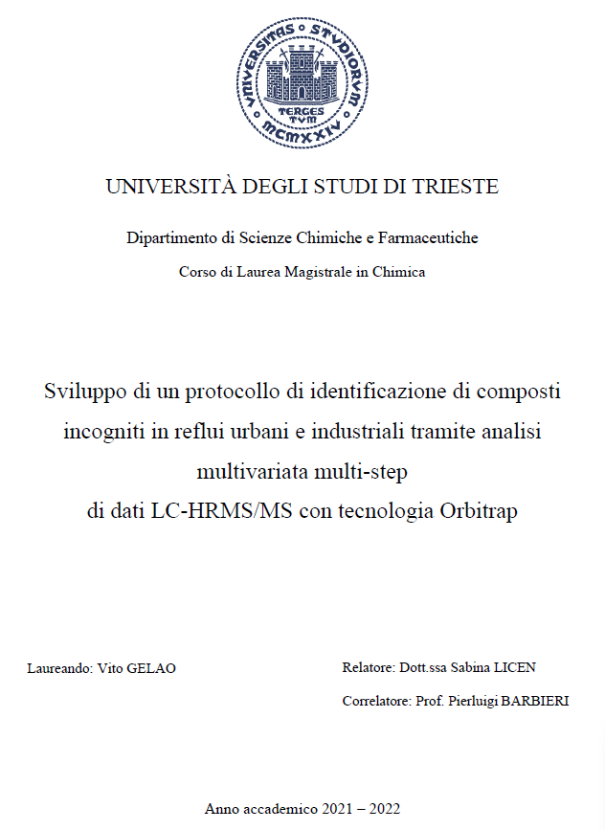
UNIVERSITY OF TRIESTE
Department of Chemical and Pharmaceutical Sciences
Master's Degree Course in Chemistry
Development of a protocol for the identification of unknown compounds in urban and industrial wastewater through multivariate multi-step analysis of LC-HRMS/MS data using Orbitrap technology
Graduand: Vito GELAO
Supervisor: Dr. Sabina LICEN
Co-supervisor: Prof. Pierluigi BARBIERI
Academic Year 2021 – 2022

Slide 13
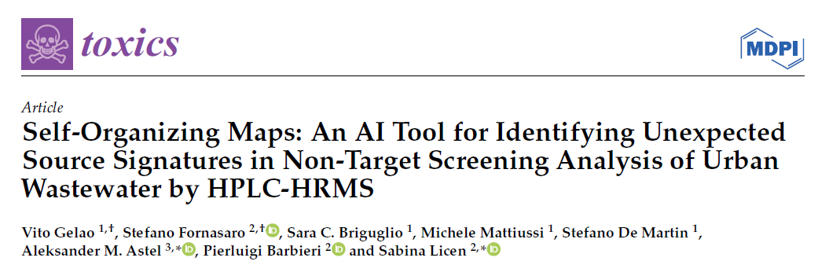
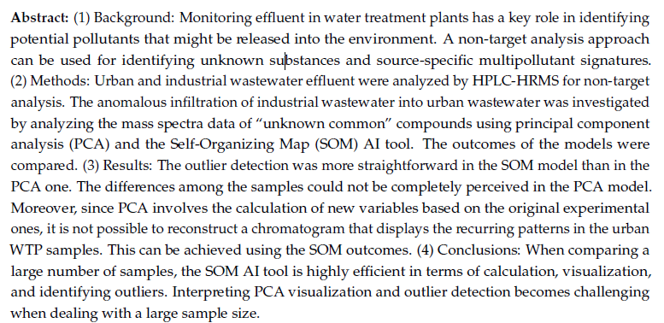
2024, 12, 113. https://doi.org/10.3390/toxics12020113

Slide 14




OP2366 Towards Community Health Surveillance in Wastewater Treatment Plants and More – Setting Up Methods and Chasing Antibiotics, Microorganisms and AMR in Untreated Waters and Bioaerosols
A.S. Gaetano^{1a}, S. Semeraro^{1a}, S. Fornasaro^{1a}, S. Licen^{1a}, V. Gelao², S. Briguglio², S. De Martin², C. Ametrano^{1b}, F. Malfatti^{1b}, A. Cain³, F. Barbone^{1c}, A. Pallavicini^{1b},
P. Barbieri^{1a}
1a University of Trieste, Department of Chemical and Pharmaceutical Sciences
1b University of Trieste , Department of Life Sciences
1c University of Trieste, Department of Medicine, Surgery &Health Sciences
2 ARPA FVG, SOC Laboratorio Multisito
3 ACEGASAPS AMGA

Slide 15
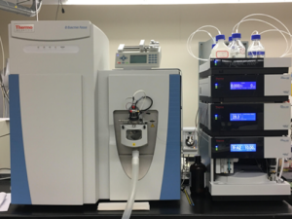
Friuli Venezia Giulia
Regional Environmental Protection Agency
CHEMISTRY – Analytical method
UHPLC Ultimate 3000 Dionex
Column Ascentis Express C18 (150 x 2.1 mm, 2.7 μm, Supelco)
Eluents: A) 5 mM formiate buffer; B) MeOH.
Flow: 0.3 ml/min
HR Mass spectrometer Orbitrap Q-Exactive Focus
Source parameters: Sheath gas flow rate 44
Auxiliary gas flow rate 12
Spray voltage (kV) 3.30
Capillary temp 290 °C
S-lens RF level 50.0
Auxilary gas heater temp 280 °C
Full MS with discovery (ddMS2= data dependent MS2)
Polarity positive
Full Scan resolution 70000
Scan range 75-1000 m/z
dd-Ms2 Discovery resolution 17500
isolation window 2.0 m/z
NCE/stepped: 20,40,90
Untargeted screening (areas as output-8 antibiotics)
with Compound discoverer 3.3.2.31
Target analysis and quantitation (conc. as output-9 antibiotics) with TraceFinder 4.1
sara.briguglio@arpa.fvg.it
vito.gelao@arpa.fvg.it
stefano.demartin@arpa.fvg.it

Slide 16

Results: Chemical fingerprint WWTP, II
Bacteria
E= influent
U=effluent
Mechanism of action
Anti DNA synthesis
Anti Protein synthesis
Anti Metabolism
Anti Protein synthesis
Anti Metabolism
Anti Metabolism -> DNA
Anti Protein synthesis
Anti metabolism
Z-scores
C9 C10 C11 C12 C13 C14 C15 C16 C17
Abatement (Z)

Slide 17
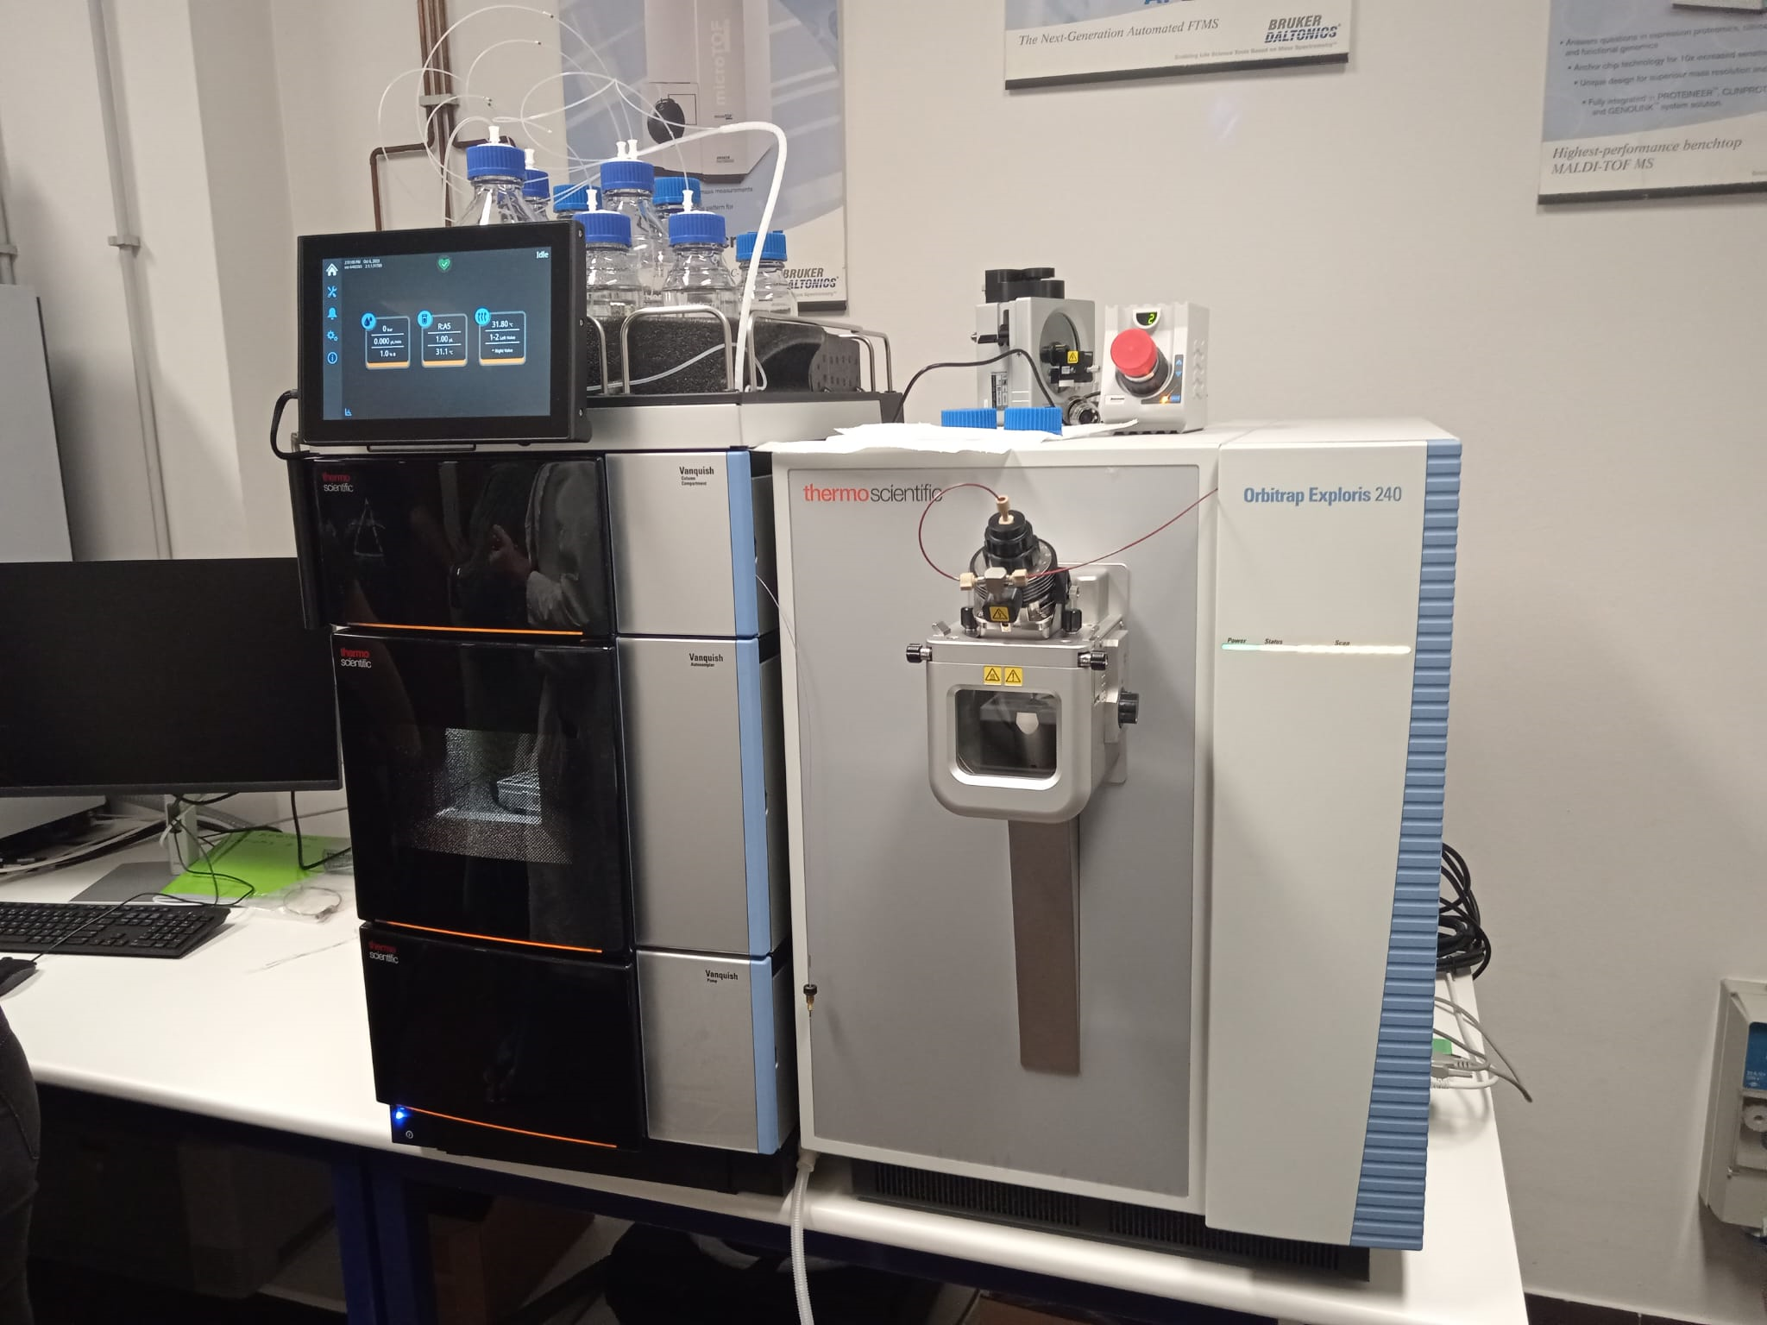

Mass Spectroscopy Lab @ Dip.Sci.Chim.Farma. –Università degli Studi di Trieste
Collaborazione con
– in arrivo
sistema LC-HRMS Thermo Scientific™ Orbitrap Exploris™ 480 abbianato al sistema UHPLC Vanquish™ Horizon
sistema LC-HRMS Thermo Scientific™
Orbitrap Exploris™ 240 abbianato al sistema UHPLC Vanquish™ Neo + postprocessing pipeline Compound Discoverer & custom IA tools
Sabina Licen - Pierluigi Barbieri
Francesca Larese – Fabio Barbone

Slide 18
Legislative process
In Parliament, the Committee on the Environment, Public Health and Food Safety, responsible for the file, adopted its report on 27 June 2023 (rapporteur: Milan Brglez, S&D, Slovenia). It reinstates the deadline for phasing out emissions of priority hazardous substances. It requires additional parameters and quality standards for the total of bisphenols and the total of pharmaceutical active substances in surface waters; and for the total of PFAS in both surface waters and groundwater. It also tightens the standards for glyphosate, atrazine and non-relevant pesticide metabolites.
Given the vulnerability of the groundwater ecosystem, the report demands that the threshold values applicable to groundwater be 10 times lower than the corresponding standards for surface waters, except in certain cases (where the actual risk posed to the groundwater ecosystems can be established, it may be appropriate to set threshold values for groundwater at a different level). To improve groundwater protection, the Commission would have to assess, within 4 years of the directive's entry into force, the impacts of physico-chemical elements (such as pH, oxygenation, temperature) on the health of groundwater ecosystems; and the chemical status of areas of high ecological value, vulnerability or pollution (such as caves and karst areas and former industrial sites).

Slide 19

BILANCIO IDRICO TRANSFRONTALIERO DEI BACINI IDROGEOLOGICI CON METODOLOGIE INTEGRATE E DI ADATTAMENTO AI CAMBIAMENTI CLIMATICI
ČEZMEJNA VODNA BILANCA HIDROGEOLOŠKIH POREČIJ Z INTEGRIRANIMI METODOLOGIJAMI IN PRILAGAJANJEM PODNEBNIM SPREMEMBAM
Grazie per l’attenzione! / Hvala za pozornost!
SEGUCI / SLEDI NAM:
www.ita-slo.eu/wabin
facebook.com/Interregwabin
Interreg Italia-Slovenija WABIN
Contatti/ Kontakti Pierluigi Barbieri
e-mail: barbierp@units.it
INTERREG ITA-SLO WABIN – Seminar “The problem of transboundary waters” and Kick Off Meeting
Trieste Urban Center – 05/07/2024

